Slide 1


Digital Marketing & Sales Integration.
Lynn Christiansen Esquer
FEBRUARY 2020

Slide 2
Marketing’s 2020 Focus
Streamlining and focusing our lead generation, nurture & marketing-to-sales handoff
Demand Generation Mix
  Inbound
  ABM
  Targeted Regional Events

Slide 3
Marketing’s 2020 Focus
Why?
Lead leakage
Cohesive, targeted
Pipeline
Cost effective

Slide 4
How the Lead Process Now Works
•Lead: Someone whose contact information and/or IP address we have captured in some way that we can nurture. Includes subscribers and contacts.
•MQL: Marketing Qualified Lead. Contact has converted on a form, talked to us at an event, or in some way demonstrated interest in Preempt. Often we know they have demonstrated interest in a particular offering and are being nurtured according to that interest to further qualify.
•SQL: Sales Qualified Lead. When a lead becomes sales qualified — either by fulfilling our lead scoring during the nurture process (lead score 30+) because of actions they have taken, or because they have agreed to a meeting (fulfilling BANT methodology or other). This is when the SDR becomes involved for inbound leads.
•SAL: Sales Accepted Lead. Lead has demonstrated valid interest after initial meeting(s), meaning that they have an initiative, a line to budget and agreed-upon next steps. If the SAL is later disqualified by the rep (because of BANT reasons or other that sales will need to specify), it will go into to primary buckets:
  •Active SAL: Sales is actively working to turn them into an opportunity
  •Inactive SAL: We will categorize these into “Not right time/budget but could change”, “Unresponsive; previously engaged”, “Can’t service”, “Can’t service but on roadmap” and “Lost SAL/Not moving forward”
•Opportunity: SAL has developed into a sales opportunity that is forecastable (deal close date and amount). These will turn into one of two things: a Customer, or a Lost Deal.

Slide 5
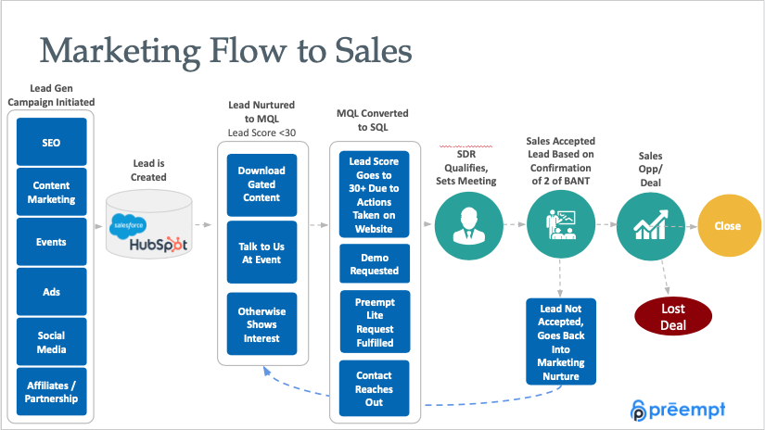

Slide 7
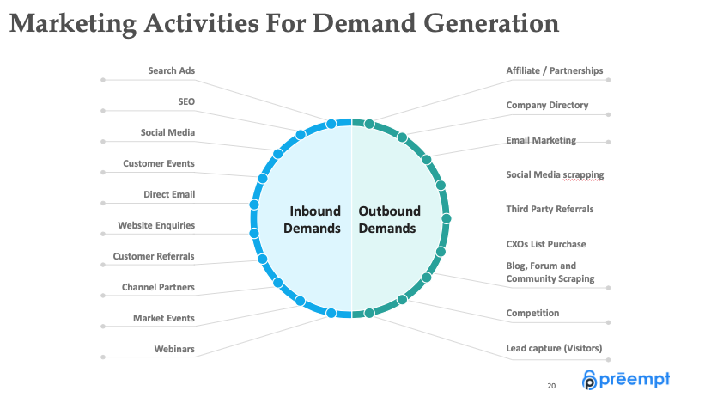

Slide 9
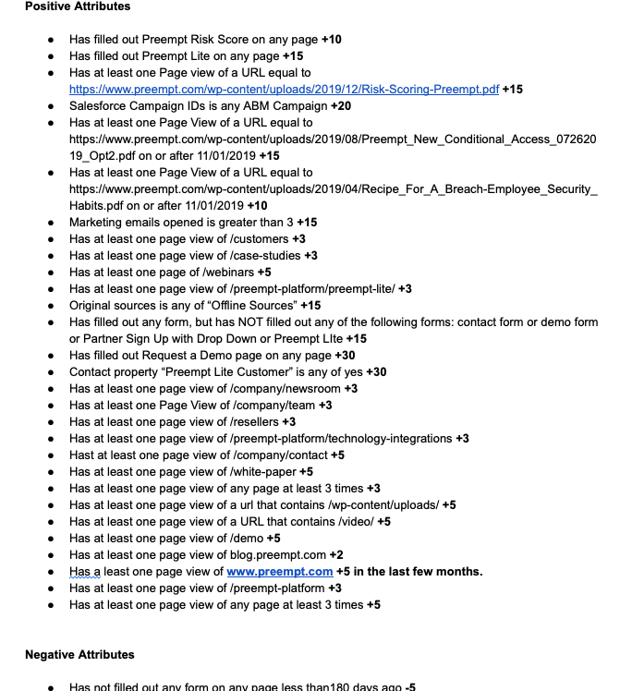
Lead Scoring

Slide 10
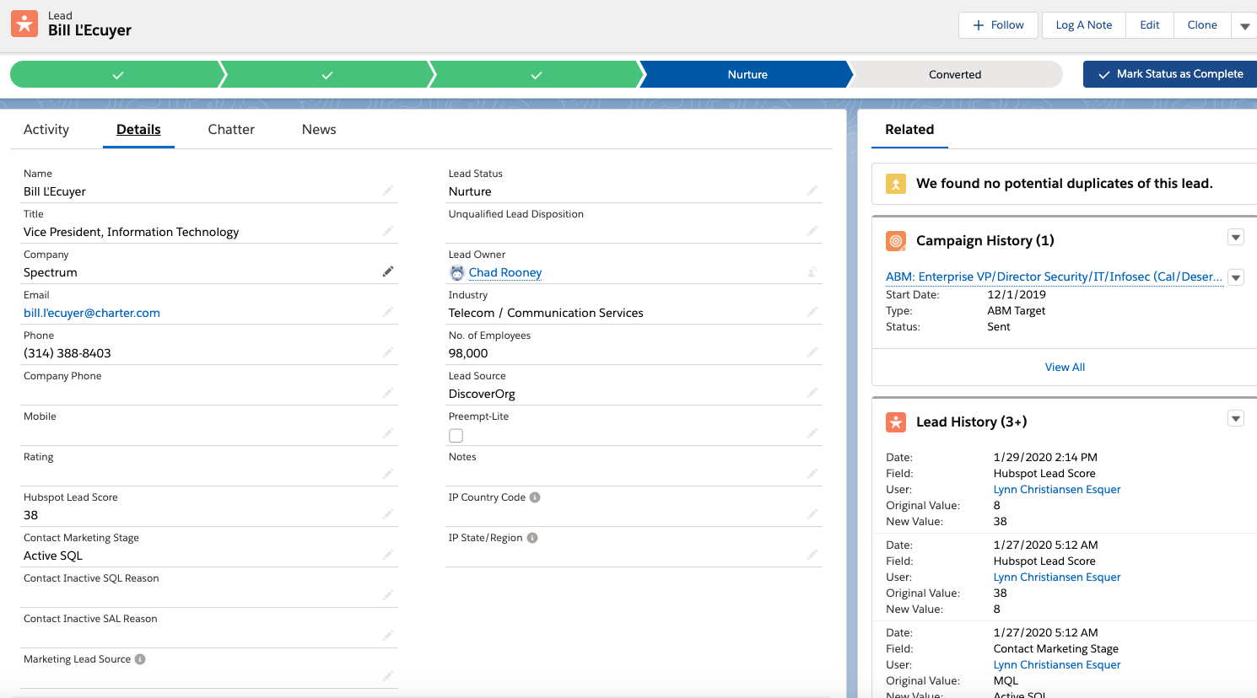

Slide 12
SDR Discovery – B.A.N.T.
Size of organization
Industry/vertical
Title/authority or influence
Active or planned project/initiative
Timeline
Need/Why are they interested in a meeting?
Any other qualifying questions (what they might have in place, special considerations, etc)
If satisfactory, SDR involves sales team for meeting
If opportunity is possible, moves to SAL in Salesforce

Slide 14
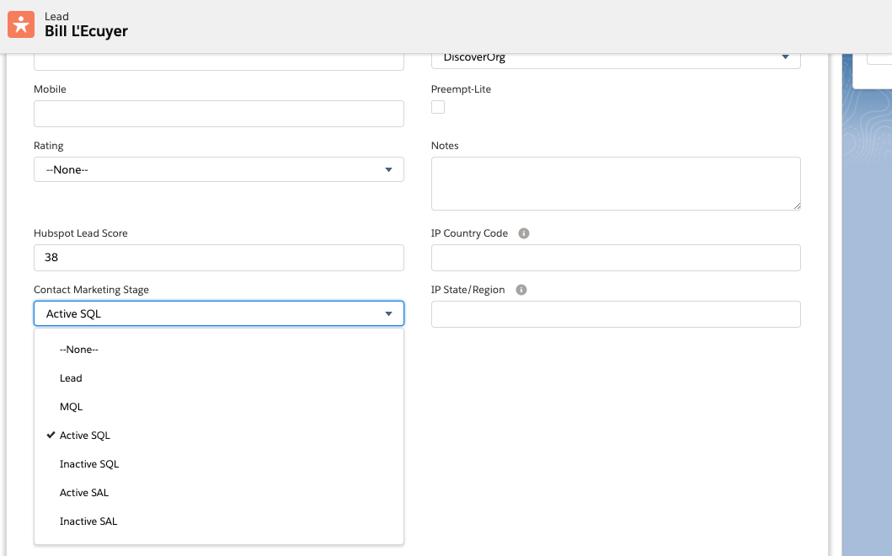

Slide 15
Inbound Marketing

Slide 16
Why Inbound?
Casting a wide net versus using bait
ROI, more cost effective
Better chance of capturing people truly searching for solutions
Empowers buys with helpful content rather than interrupting them with irrelevant communications; Lets customers reach us on their own terms
Targets specific personas, resulting in higher quality leads with more information about them
Builds relationships/personalized
Moves leads through the process/sales funnel

Slide 17
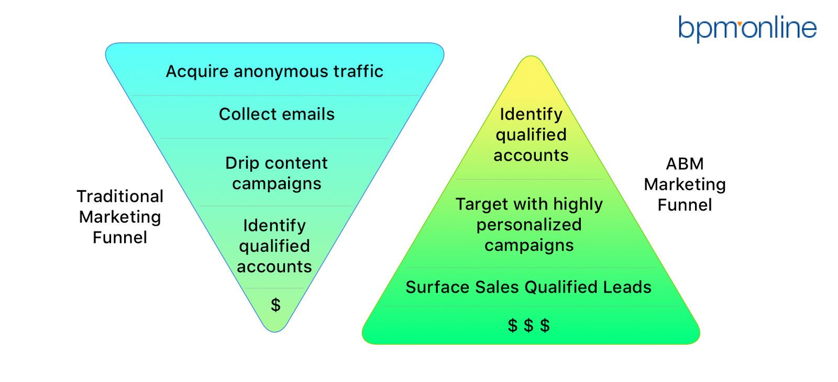
What We’re Doing
Attraction: Events, list builds, some ads, SEO, content/webinars, social media
Nurture: Email, SDRs
Pushing leads through the funnel to take additional steps
Lead scoring
Creating process and visibility

Slide 18
What Success Looks Like
In process of creating concrete, numeric goals now that we have baseline
Better marketing to sales pipeline
Better efficiency/ROI/CPL
Increased qualified lead flow and lead ratio from lead to opportunity. i.e.:
MQL → SQL → SAL → Opportunity/Deal → Customer
Deal velocity

Slide 19
Successes/Progress
Overall numbers are improving
MQL → SQL → SAL → Opportunity/Deal → Customer
Nurture efforts have vastly improved in past year – ways to reach people at all stages and interests
Sales pipeline dramatically improved in past year
Preempt Lite
Lead flow refined, handoff to sales: Less leakage
Rolling out improved messaging

Slide 20
What We’re Doing Now
Creating visibility for sales into marketing activity
Working on refining messaging and targeting efforts
Measurement and refinement
Will be adding in or rebooting some marketing efforts now that the basics are being refined

Slide 21
ABM Marketing — What is it?
ABM is short for account-based marketing, a B2B strategy that focuses sales and marketing resources on target accounts.
Long on our backburner, implementation of an ABM program to supplement our inbound marketing was one of our goals for FY2020. The aim is to help sales get into desired accounts at every relevant purchase or influencer title with messaging tailored to their interests and pain points.

Slide 22
Why ABM?
ABM helps get multiple decision makers and influencers within an account on board using relevant communications. Industry analytics show that an average of 7 people are involved in most buying decisions in even smaller firms, according to Gartner
ABM helps align marketing and sales, which can result in closing deals at an increase of 67%, according to Marketo
ABM gives organizations a better chance of retaining and expanding customer relationships

Slide 23
What We’ve Done So Far
In November 2019, we began by asking North American sales reps about high-value enterprise and mid-market accounts they would like to target
We built out thorough contact lists that included all relevant titles that mapped to these ABM targets, then scrubbed and refined them to be as on-target for our personas as we could make them
We created five sets of email messaging on groups of titles based on our playbook
We segmented the lists to better track the performance of exact titles, as well as regional performance, and created SFDC systems and campaigns to correspond for tracking
We built email workflows from scratch to deliver these highly segmented messages to the lists on a cadence and launched in early December for Mike, Josh, Paul and Bill (Vince – enterprise only - launched in January). These workflows were built to track any activity taken by ABM targets (site visits, form downloads, email click-throughs) and log this activity on contact records (and eventually, reports). Activity would naturally lead to higher lead scoring and turn active ABM targets into sales-qualified leads (SQLs)

Slide 24
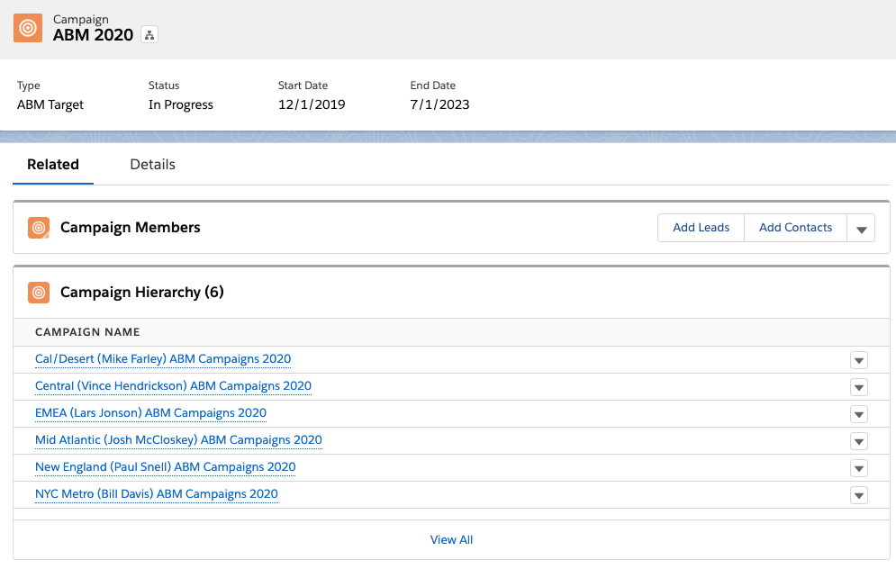
New ABM Strategy
ABM:
Account-Based
Marketing

Slide 25
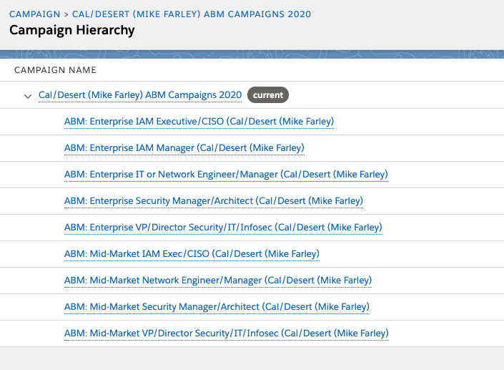
New ABM Strategy
ABM:
Account-Based
Marketing

Slide 26
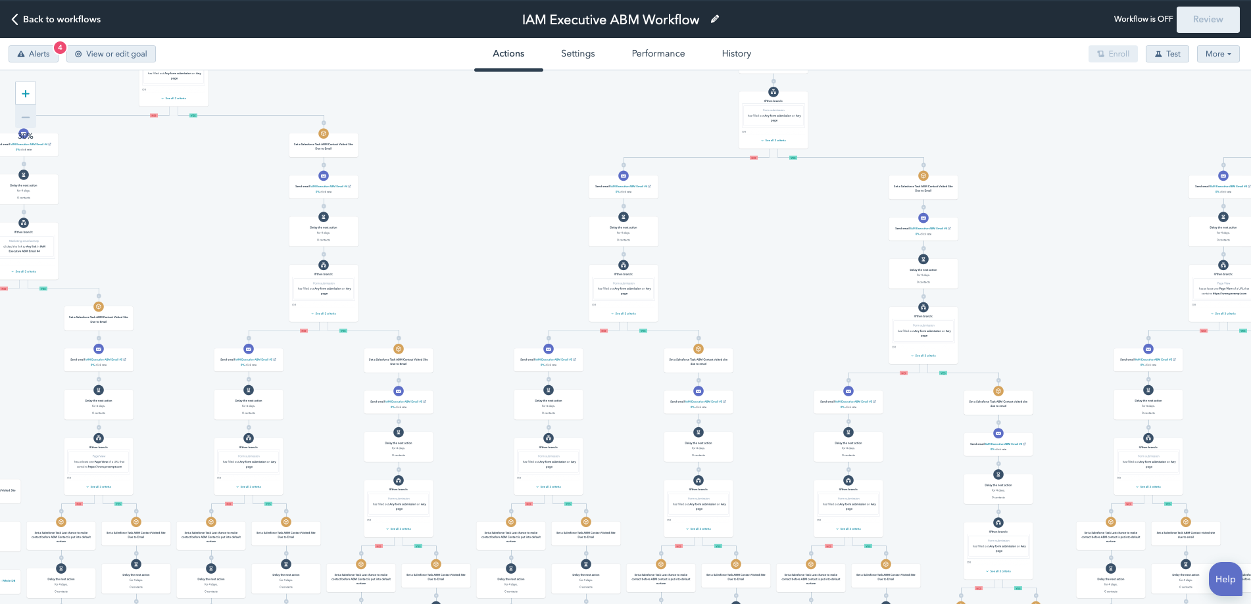

Slide 27
What We’re Working On Now
We are continuing to build out these campaigns to extend these over a few months but are studying messaging success
Multi-touch: Add in codified cadences from SDRs, specific events, advertising, etc. to support efforts
We are building out dashboards in SFDC so that each rep, SDR and Patrick have transparency into ABM activity and which accounts are showing activity by individuals
SDRs are tracking activity by SQLs but waiting to schedule meetings until hands are raised as a result of our nurturing
We are planning to add mid-market accounts to Vince’s campaigns, and to begin Lars EMEA campaigns this week
We are measuring for success and using metrics to adjust accordingly: Recording, dashboards, improving performance
We can begin to add other target accounts when reps suggest more
Channel/Alliances

Slide 28
What Success Looks Like
Concrete, numeric goals for the ABM program specifically were undefined at the onset (because baseline metrics were unavailable) but the program was implemented with the knowledge that Q3 pipeline would require marketing-generated opportunities and that deal velocity needed acceleration, particularly with enterprise-level prospects
Lead flow and lead ratio from identified target account to opportunity. All ABM targets start as marketing-qualified. i.e.:
MQL → SQL → SAL → Opportunity/Deal → Customer
Other measurements: Deal velocity, customer lifetime value, customer acquisition cost, program efficiency (ROI)

Slide 29
Two Months In: What Are Our Results?
CONVERSION RATES:
5,755 ABM Targeted Individuals (MQLs) → 100+ contact SQLs
MQL → SQL 1.74%
SQL → SAL 1%
HIGHEST-ACTIVITY ACOUNTS: Otherwise known as number of people responding in some way to our marketing in each account: Kaiser Permanente, Horizon Blue Cross/Blue Shield of New Jersey; New York Life; Royal Bank of Canada; Symantec; Wells Fargo
EMAIL METRICS: 954 email opens (4.38%); 363 clicked links in at least one email (1.35%); 154 visits to at least one web page = Education/Awareness/Impressions
OPEN RATES: IAM Manager Enterprise E workflow is by far the top performer with opens of above 12% for almost all, and up to 21%.
CTR: CTR is excellent, largely between 9% and 67% with an average of 34.69%

Slide 30
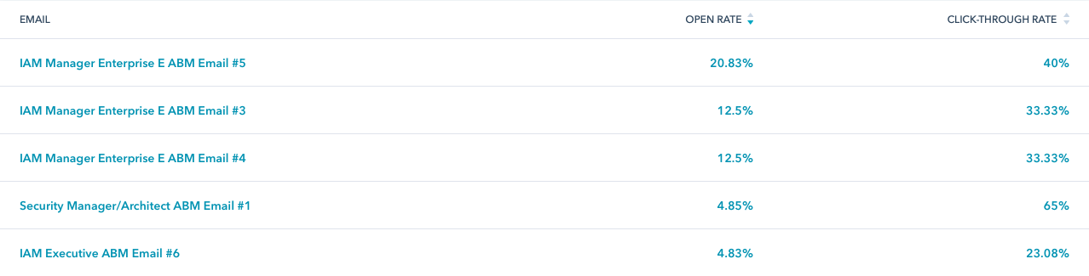
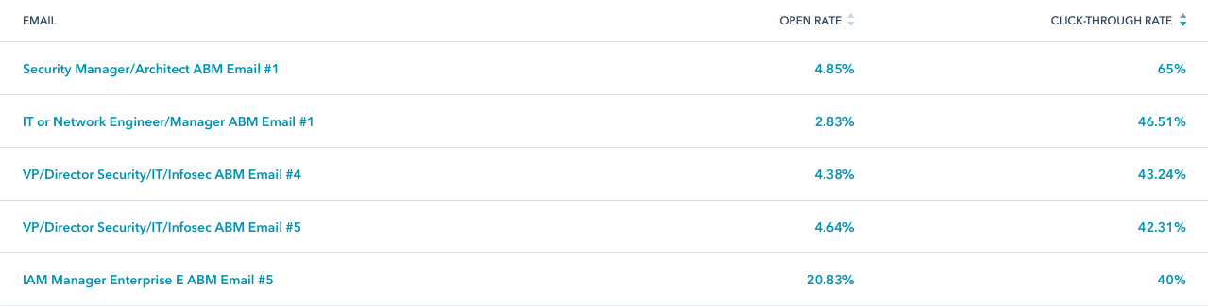
Two Months In: What Are Our Results?

Slide 31
Targeted Regional Events & Event Strategy
Customer anchored events when possible
Goal-oriented
More strategic and meaningful, less scattershot
Lower cost per opportunity
Higher chance of success
Better relationships

Slide 32
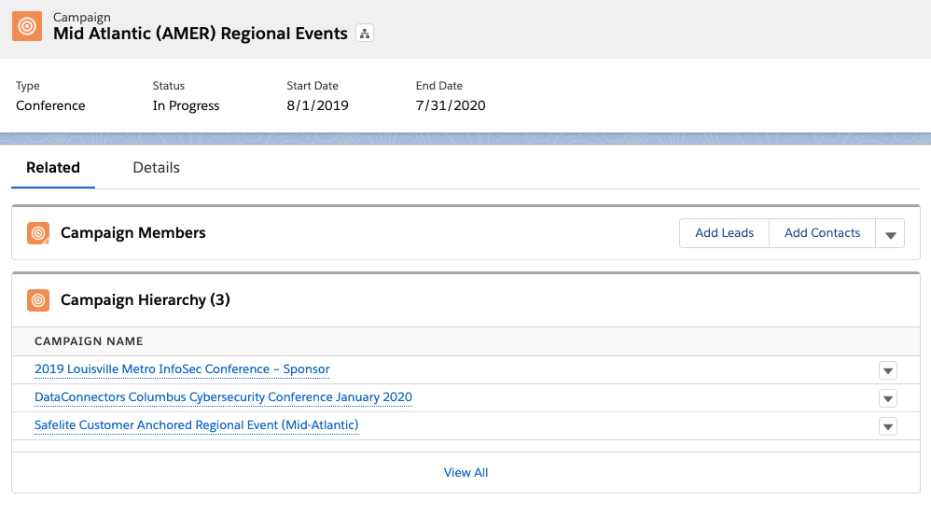
Events

Slide 33
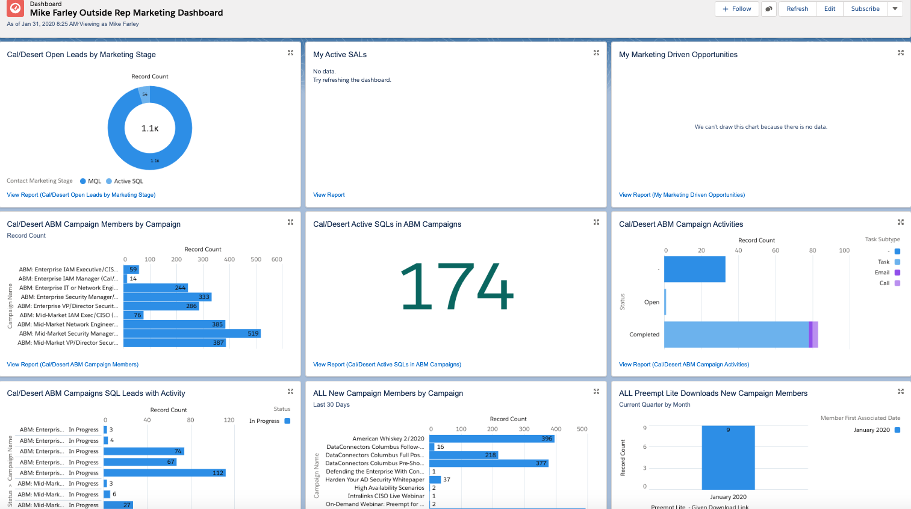
Dashboards

Slide 34

Thank You!

